Slide 1
Processes
Some additional slides
Taken from courses
By Prof. Chester Rebeiro,
Prof. Mandar Mitra,
Prof. Barsha Mitra
On top of slides from
Textbook

Slide 2
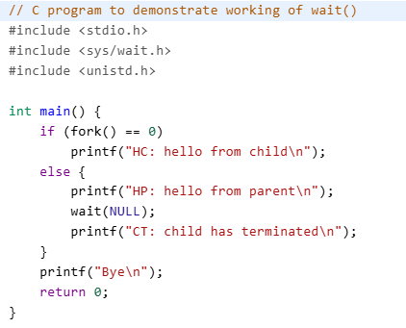
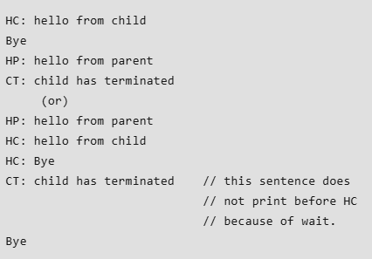
Wait examples

Slide 3
Questions on wait
What if the parent creates 2 processes and calls 1 wait?
How does the parent waits for a specific pid?
See waitpid
How do you interpret the status of the status returned by your child?
WIF
Why do we call &status?

Slide 4
Child status information
Status information about the child reported by wait is more than just the exit status of the child, it also includes
normal/abnormal termination
termination cause
exit status
For find information about status, we use WIF….macros
WIFEXITED(status): child exited normally
WEXITSTATUS(status): return code when child exits
WIFSIGNALED(status): child exited because a signal was not caught
WTERMSIG(status): gives the number of the terminating signal
WIFSTOPPED(status): child is stopped
WSTOPSIG(status): gives the number of the stop signal

Slide 5
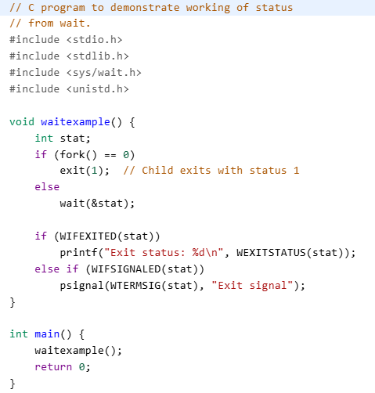
Wait with status
Exit status: 1

Slide 6
https://www.ibm.com/docs/en/zvm/7.3.0?topic=descriptions-waitpid-wait-specific-child-process-end
https://www.gnu.org/software/libc/manual/html_node/Process-Completion-Status.html

Slide 7
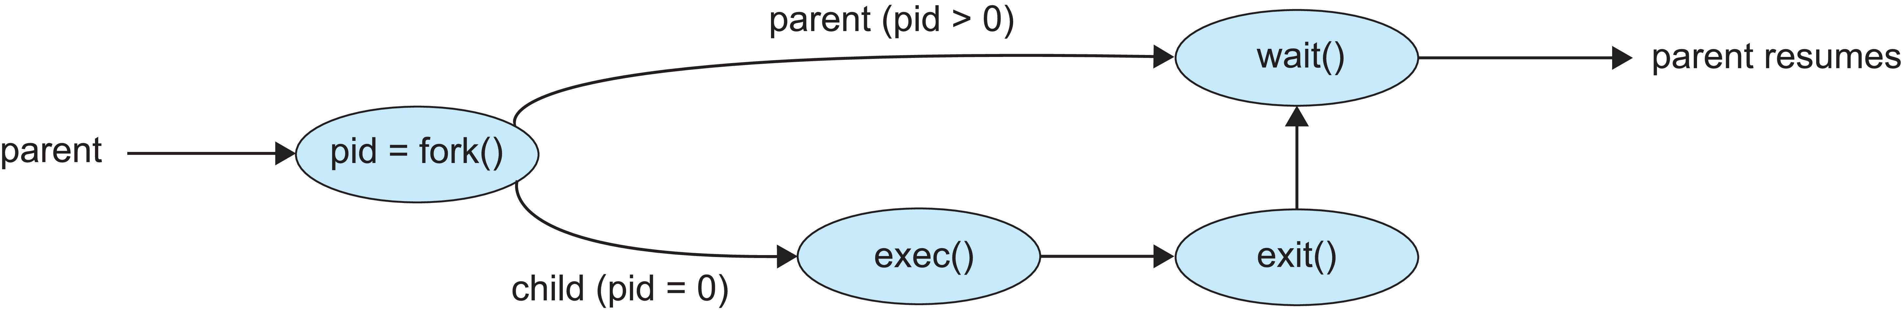
Parent and Child different tasks
exec() system call used after a fork() to replace the process’ memory space with a new program
exec() family of functions
Erase the current process image from child process
Loads a new process image
Defined in unistd.h
int execlp (const char *path, const char *arg1, const char *arg2, .., const char *argN, NULL);
path of the binary file to be loaded
Strings arg specify the arguments / commands with which the binary file is to be executed
NULL specifies the end of the argument list
NOTE: since the process image has been over-written, it does not return on successful execution – returns -1 only if error

Slide 8
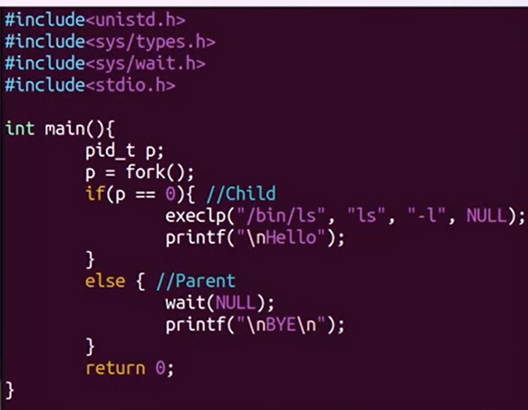
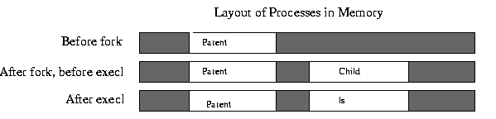
Some more examples
Parent waits
Question: Will hello
be printed?
BYE will be printed only
after ls –l output
Binary file corresponding to ls
has replaced the original binary file of the child

Slide 9
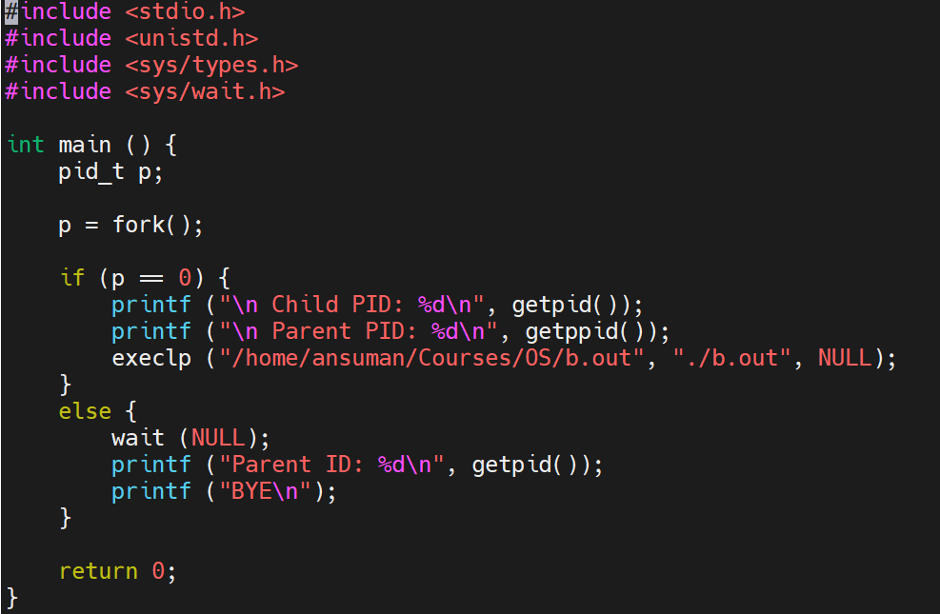
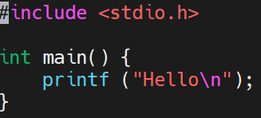
Some more examples
gcc b.c –o b.out
gcc a.c –o a.out
./a.out
b.c

Slide 10
Process Termination
Finishes execution of final statement
Invokes exit() – directly or indirectly (return statement)
Returns its status to parent – if parent called wait() and passed some non-NULL argument in wait
0 for normal termination, non-zero exit value if abnormal
Allocated resources reclaimed by the OS
Processes can also be terminated by the kill command
Parent process can terminate a child process
Parent needs to terminate
Task assigned to child is no longer needed

Slide 11
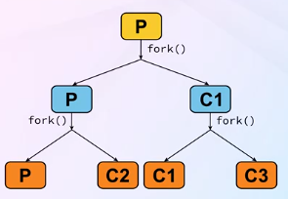
Process Termination
In some OS, when parent terminates, child processes also terminate
Cascading termination – all descendants terminate when a parent terminates
Termination of P causes termination of C1, C2, C3
In Linux, no cascading termination – child can continue to execute

Slide 12
Zombie
P is a process (parent)
C is a child process created by P
C terminates
P did not call wait()
C becomes a Zombie
C not removed from the process table (list of processes)
At a later point of time, P may call wait to collect status
C remains Zombie till parent calls wait
When P calls wait, C’s entry is removed from process table
Every process may become Zombie even if for a brief period
ps –el | grep Z

Slide 13
Orphan
Suppose C is executing
Parent process P terminates (did not call wait)
C continues to execute
C becomes an Orphan
When C terminates, C becomes a zombie
Nobody to collect exit status
init process is assigned as a parent of C
Entry of C is removed from the process table

Slide 14
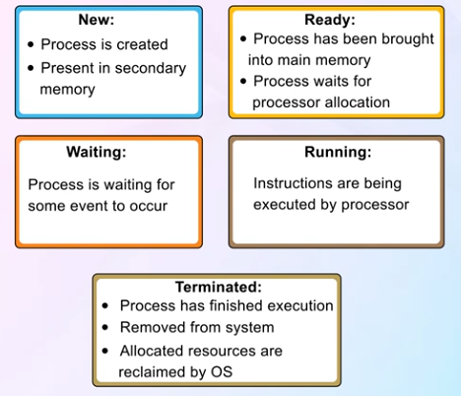
States of a Process

Slide 15
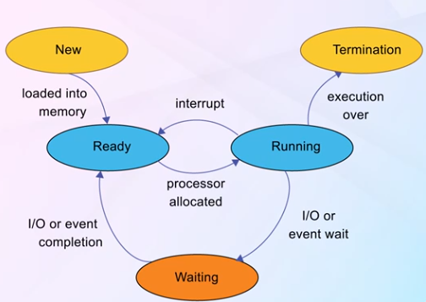
Process State Transition

Slide 16
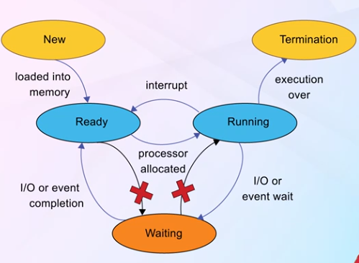
NOTE

Slide 17
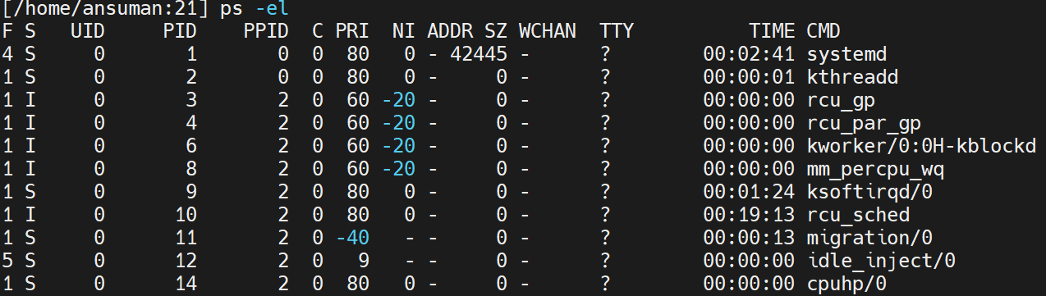
Process identification and Representation
Process is identified by a unique number
Known as Process Identifier (PID)
System-wide unique
ps –el
Process Control Block (PCB) for every process for process related info
1-to-1 map between a process and its PCB

Slide 18
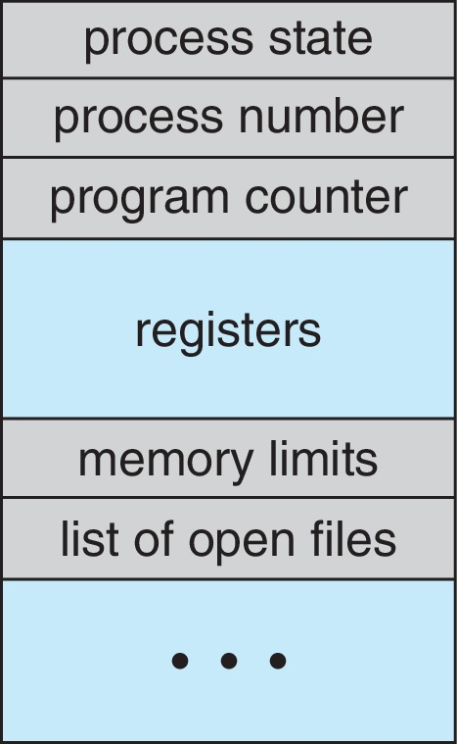
Process Control Block (PCB)
Information associated with each process(also called task control block)
Process state – running, waiting, etc.
Program counter – location of instruction to next execute
CPU registers – contents of all process-centric registers (e.g. accumulator, index, GPRs)
CPU scheduling information- priorities, scheduling queue pointers
Memory-management information – memory allocated to the process, contents of various data structures related to mem mgt (e.g. page table, segment tables)
Accounting information – CPU used, clock time elapsed since start, time limits
I/O status information – I/O devices allocated to process, list of open files

Slide 19
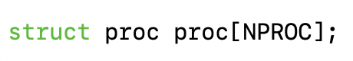
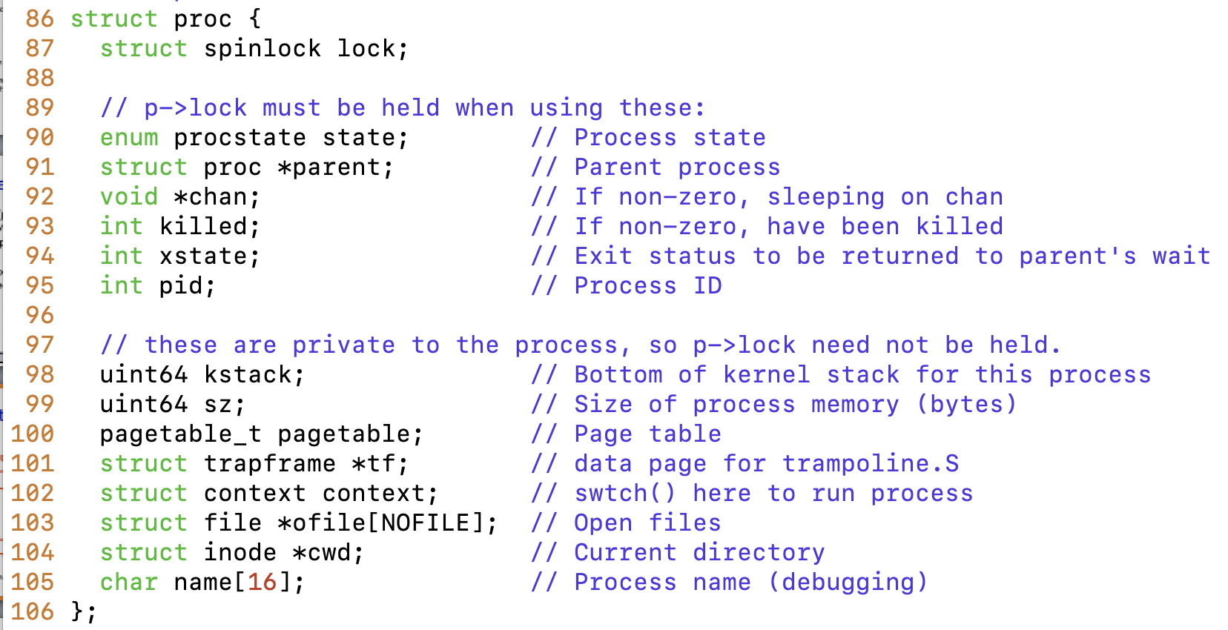
Summary of entries in PCB in xv6
proc.c
proc.h

Slide 20
Process Scheduling
Process scheduler selects among available processes for next execution on CPU core
Short-term CPU scheduler
Long-term scheduler controls the degree of multi-programming (number of processes in memory) – invoked when processes leave
Medium-time scheduler
Goal -- Maximize CPU use, quickly switch processes onto CPU core
Processes are I/O bound or CPU bound or a mix
Maintains scheduling queues of processes
Ready queue – set of all processes residing in main memory, ready and waiting to execute
Wait queues – set of processes waiting for an event (i.e., I/O)
Processes migrate among the various queues

Slide 21


Scheduling Runnable Processes
Running
Process
interrupt
every 100ms
Queue of RUNNABLE Processes
CPU
Scheduler
Scheduler triggered to run when timer interrupt occurs or when running process is blocked on I/O
Scheduler picks another process from the ready queue
Performs a context switch

Slide 22
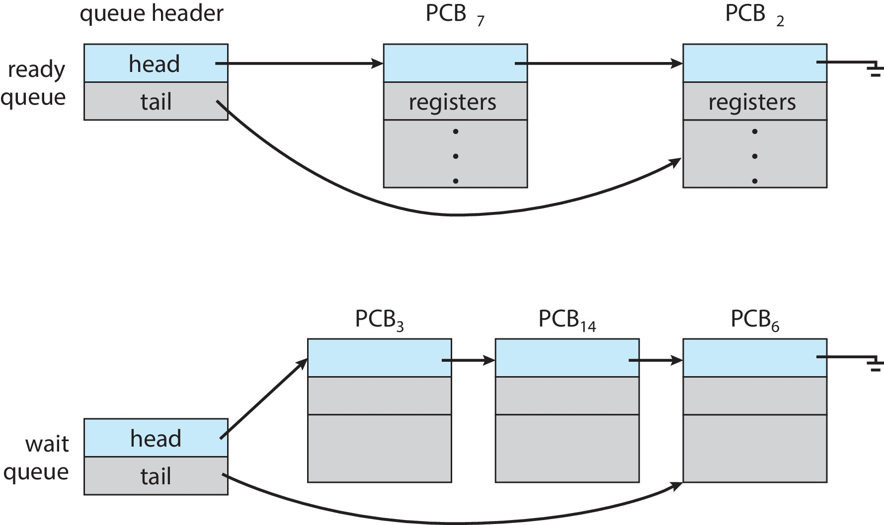
Ready and Wait Queues

Slide 23
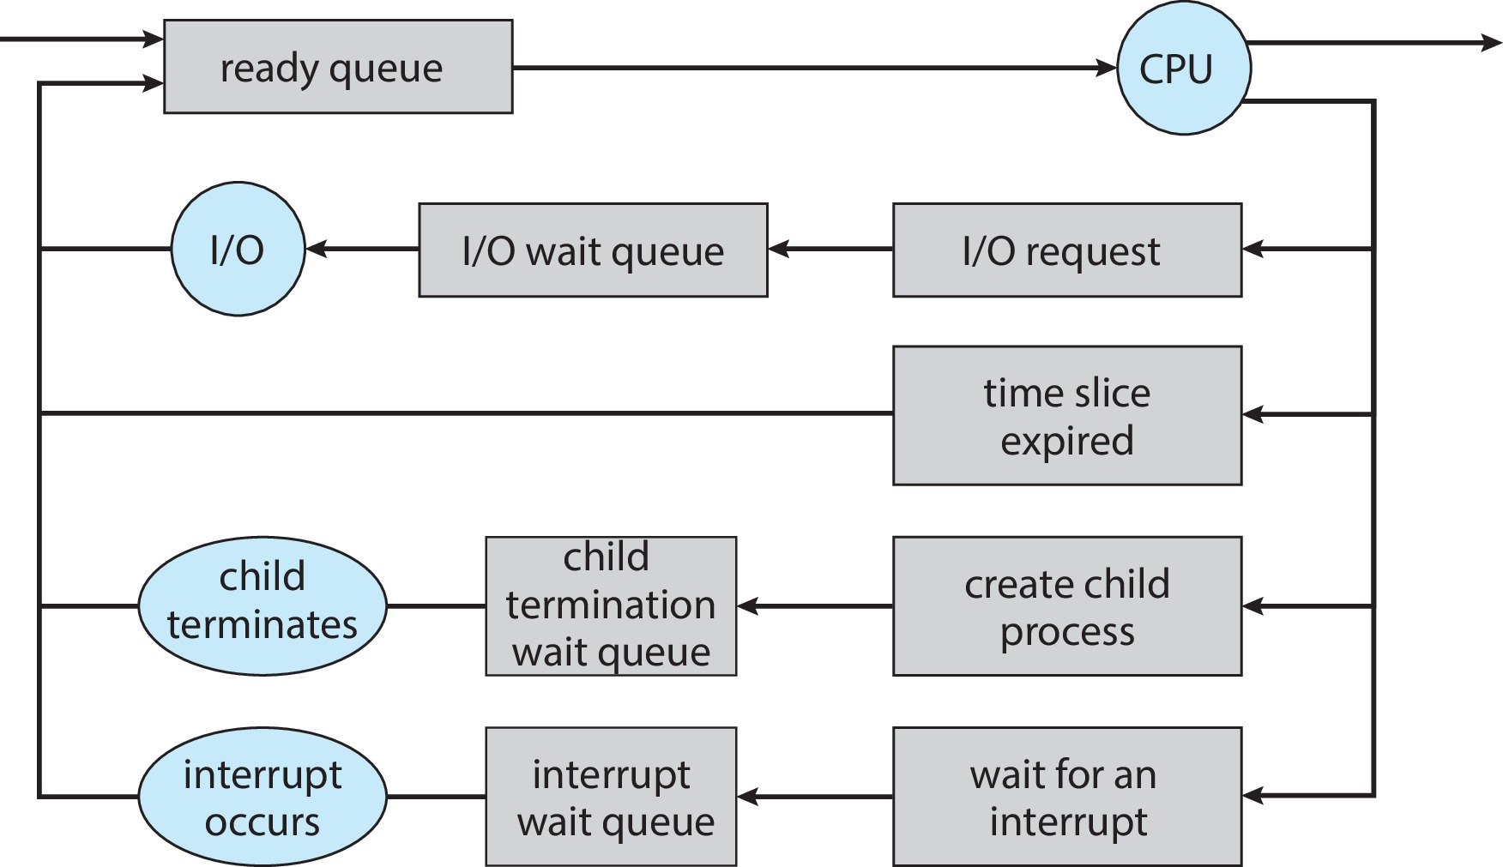
Representation of Process Scheduling

Slide 24
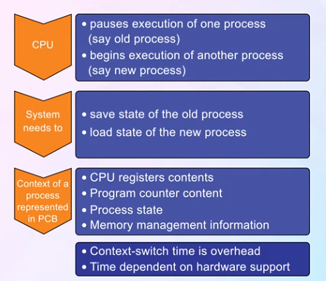
Context Switch
The system does no useful work while switching
The more complex the OS and the PCB ➔ the longer the context switch

Slide 25
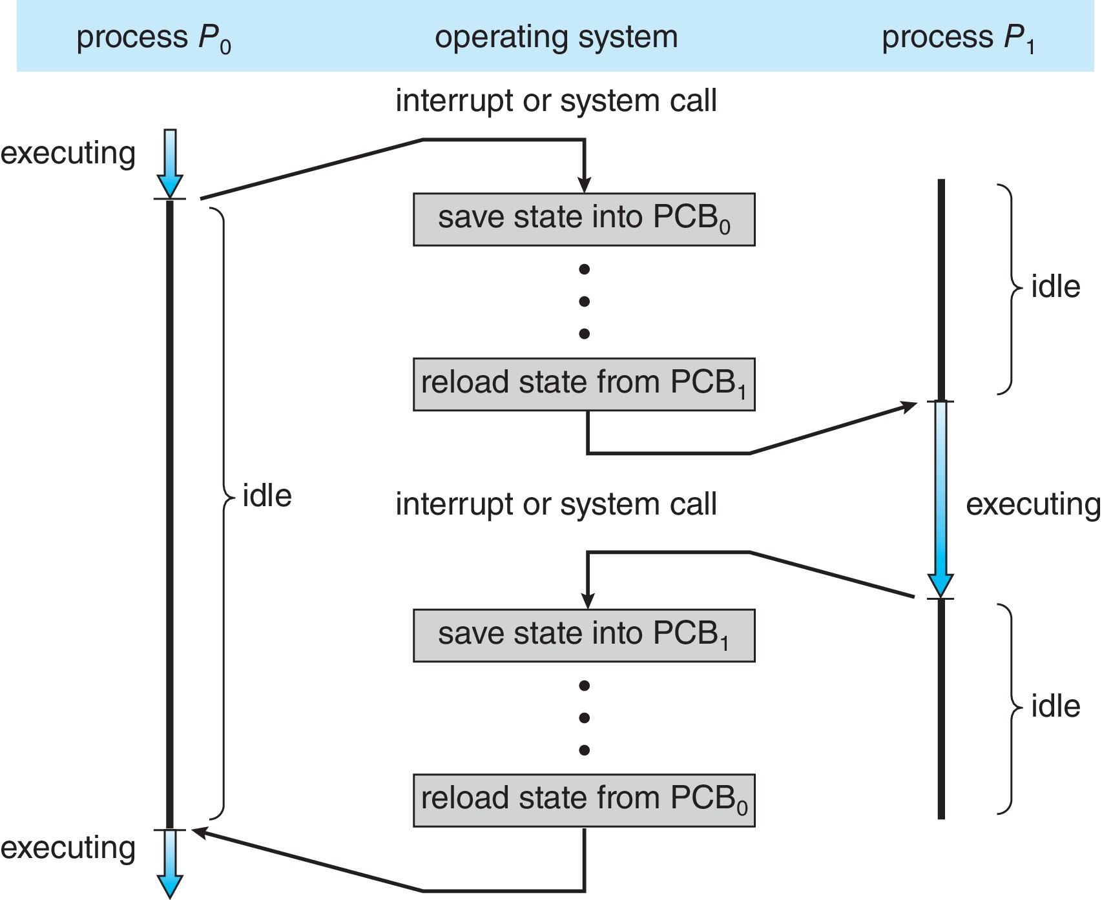
CPU Switch From Process to Process
A context switch occurs when the CPU switches from one process to another.
Question: Where
Is PCB stored?

Slide 26
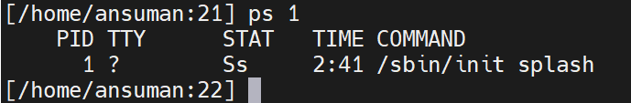
The first process
Linux : /sbin/init
Unlike the others, this is created by the kernel during boot
init has pid = 1
init executes as long as system operates
ps 1
Super parent.
Responsible for forking all other processes
Makes the system ready for subsequent user processes
Typically starts several scripts present in /etc/init.d in Linux
mounts the file system

Slide 27
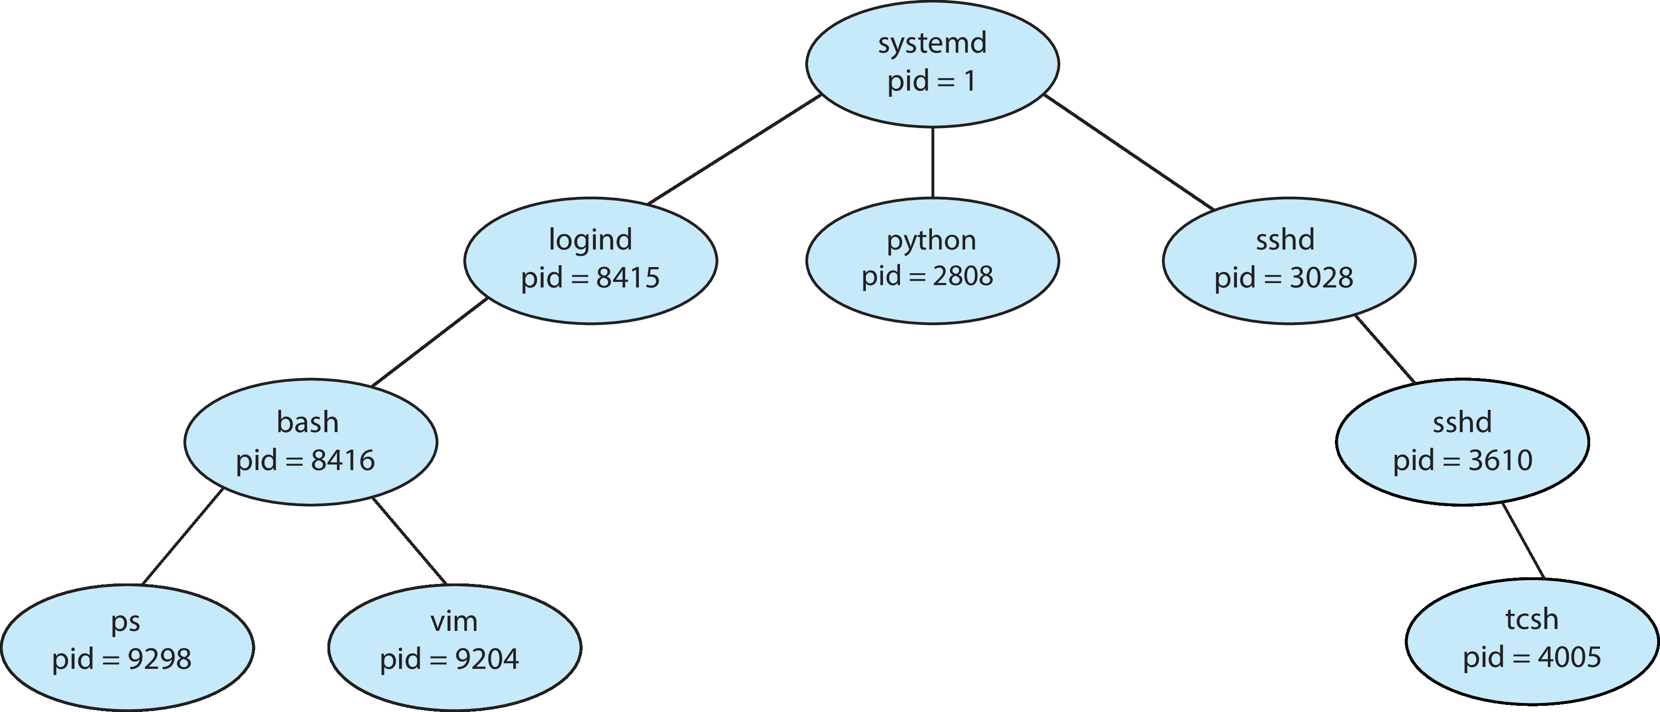
A Tree of Processes in Linux
init
Linux: pstree

Slide 28

Multiprocess Architecture – Chrome Browser
Many web browsers ran as single process (some still do)
If one web site causes trouble, entire browser can hang or crash
Google Chrome Browser is multiprocess with 3 different types of processes:
Browser process manages user interface, disk and network I/O
Renderer process renders web pages, deals with HTML, Javascript. A new renderer created for each website opened
Runs in sandbox restricting disk and network I/O, minimizing effect of security exploits
Plug-in process for each type of plug-in

